Slide 1


Introduction to Data Analytics
- Abhilash Nagaraja
Notes:
Give you guys an overview of what Data Analytics is all about.
The buzz about Data Analytics
The demand and growth
Tools
Applications

Slide 2


Agenda
Defining Data Analytics
Applications
Friendly tools
Key elements of Data Analytics
Introduction to Statistics
Descriptive and Inferential Statistics
Notes:
Intro is about brushing up data analytics
I would also be sharing every now and then my experiences

Slide 3


Why Analytics?
Notes:
Why do we need Analytics?
To get the best insights out of the observations in hand
Support theories and Hypotheses made
To make reasonable predictions and help us be prepared for the future

Slide 4
What’s the buzz about ?
Business Analytics
Business Intelligence
Data Analytics
Data Science
Notes:
BA – Use of Analytical tools for making data-driven decisions in the field of Business
BI – Similar to BA but requires an expertise in domain (SME)
DA – Is the superset of BI and BA.
DS – Implementing Machine learning techniques and designing algorithms

Slide 5
The rise in demand
Increased digital footprint
Ease of access to information
Social Media revolution
Technological Advancements
Notes:
What led to the sudden raise in demand for Data Analytics & Data Science
Data is the oil.
Data is gold
Deriving information from data
Sexiest job of the 21st century

Slide 6
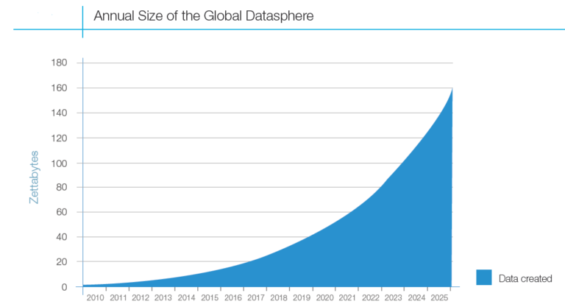
Data Growth
Notes:
1 billion Terabytes

Slide 7
What is Data Analytics?
The analysis of data, typically large sets of data, by the use of mathematics, statistics, and computer software.
Analytics is the science of using data to build models that lead to better decisions that in turn add value to individuals, companies, and institutions
Notes:
Classic definitions

Slide 8
Types of Analytics
Descriptive Analytics
Predictive Analytics
Prescriptive Analytics
Notes:
Descriptive Analytics
Mostly describes what has already occurred.
Helps us understand the underlying trend within the observations
Often answers questions like, “how are things going?”
Reactive in nature.
ex: The number of units of new iPhone sold during Thanksgiving in USA in 2019
Predictive
Gives an overview of what will happen in the future as a result of what has happened already
helps in forecasting, predicting upcoming things by extending the existing trend found within the data
predictive in nature
Prescriptive Analytics
Helps in prescribing the course of action based on predictions made
proactive in nature
helps us be prepared with measures and also make decisions when whatever predicted to happen happens

Slide 9









Friendly Tools
Notes:
SAS, SPSS – statistical analysis tools helps in doing
SAS is free. SPSS is not
Power BI, Tableau – BA tools
Open refine – data cleaning and transformation tool

Slide 10
Application Domains
Finance
Healthcare
Crime Prevention
Retail
Marketing

Slide 11
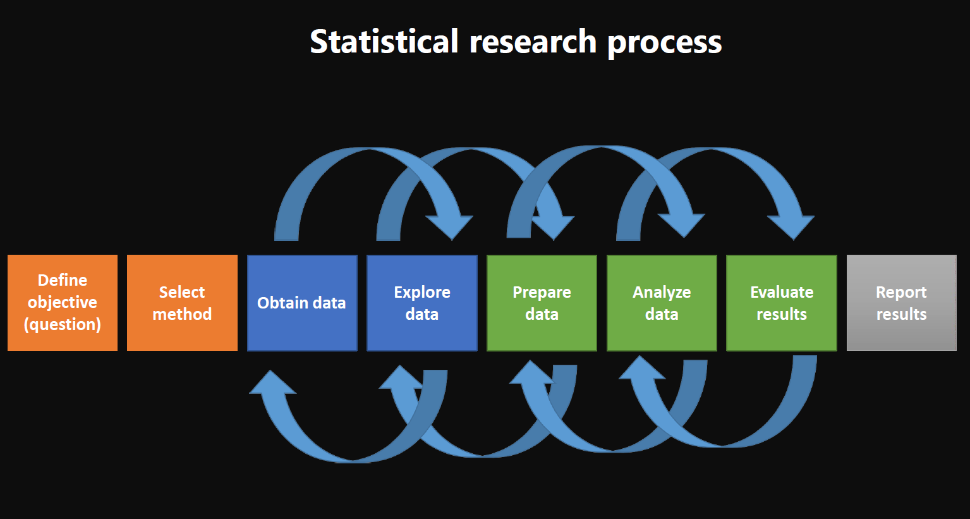
Data Analytics project workflow
Notes:
Obtaining data – gathering
Emphasize on the feedback arrows

Slide 12
Key elements
Statistics
Data Manipulation
Exploratory Data Analysis
Data Visualization
Notes:
These form the heart of Data Analytics
Also, what the lecture series is going to be about
So, lets begin with Statistics
Each aspects here will be introduced and explored in the later sessions

Slide 13
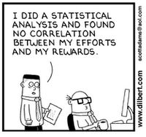
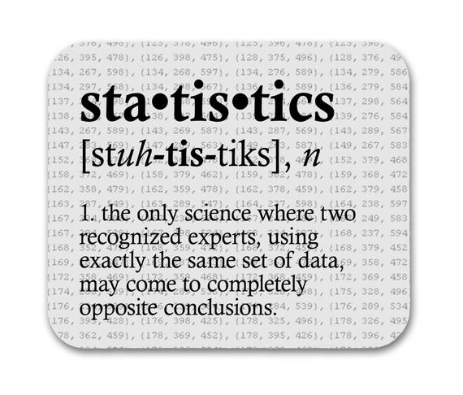
Statistics
A branch of Mathematics dealing with the collection, analysis, interpretation and presentation of masses of data
The practice or science of collecting and analyzing numerical data in large quantities, especially for the purpose of inferring proportions in a whole from those in a representative sample.
Notes:
Definitions and some funny takes

Slide 14
Branches of Statistics
Notes:
Statistics can be divided into two branches
They support each other

Slide 15

Descriptive Statistics
Analysis of data that helps describe, show or summarize data in a meaningful way such that, patterns underlying the data are revealed
Provides a general description and the characteristics of the data in hand
Often aided by performing numerical calculations, drawing tables, and plotting graphs
Notes:
If you’re given a box of candies, first thing you would do is count how many are there.
You subconsciously do it without any intent.
Count, sum, mean, median, mode, max, min, etc
We will see the measures and scales used in descriptive stats
Descriptive Statistics is intrinsic to us

Slide 16


Slide 17
Measures of Central Tendency
Mean
7.285
Median
7
Mode
7
Given a set of values: 10, 5, 7, 8, 7, 11, 3
Notes:
Measure of avg of all the values in sample
Measure of central value in the sample
Most recurring value in sample
Give an example using notepad
Most p

Slide 18
Choice of Central Tendency measure
Mean is the most popularly chosen measure in most cases. Yet, not always chosen
Median is a preferable measure
If there are a few extreme scores in the data (Outliers)
If there are some missing or undetermined values
If the data distribution is open ended
If data points are represented using an ordinal scale
Mode is a preferred choice if the data points are measured in a nominal scale
Notes:
Talk about Outliers a bit
ex: heights of students in a class
155, 153, 154, 162, 158, 155, 163, 152, 186, 159 – 186 is the outlier

Slide 19
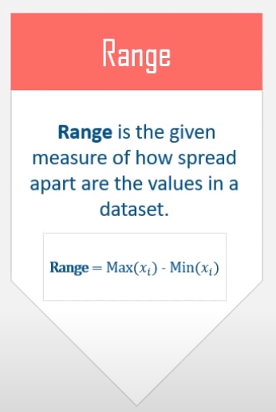
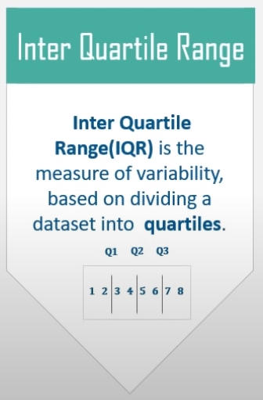
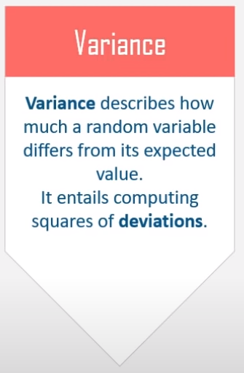
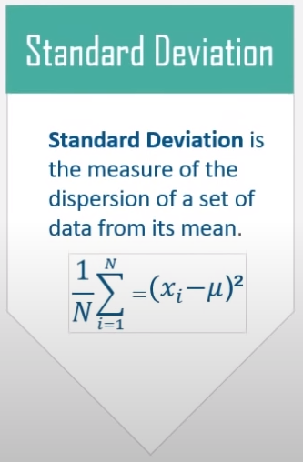
Measures of Spread
Notes:
Sd tells if the data points are standard and expected or not standard and deviated
Low sd means, data is closely clustered along the mean
High sd means, data is disbursed

Slide 20

Sample and Population
A population data set contains all members of the specified group under consideration
Ex: All the people living in India
A sample data contains a part, a subset of the population.
The size of the sample is always less than the size of the population from which it is drawn
Ex: A random selection of 1000 Indians
Notes:
Subjective in nature
a population can be a sample

Slide 21
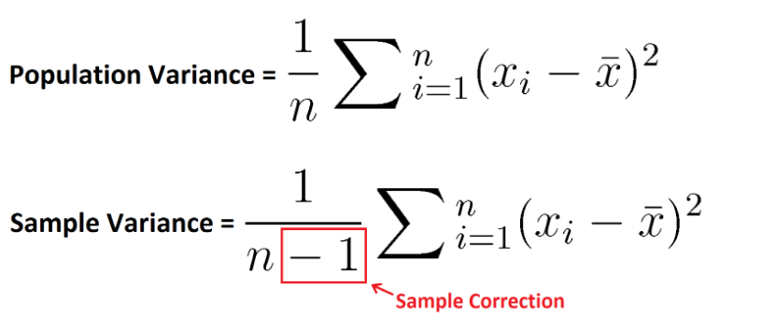
Population Variance vs Sample Variance
Notes:
Difference is because of sample having less n (atleast one less than n)

Slide 22
Inferential Statistics
Choose a data sample
Analyze and draw inferences
Make generalizations about the population
While Descriptive statistics describes the data, Inferential statistics allows one to make predictions (inferences) from that data.

Slide 23
Inferential Statistics workflow
Start
Inferential Statistical Technique
Decision making
Answers

Slide 24
Techniques in Inferential Statistics
Hypothesis Testing
Analysis of Variance
Statistical Modeling

